Slide 1


Slide 2
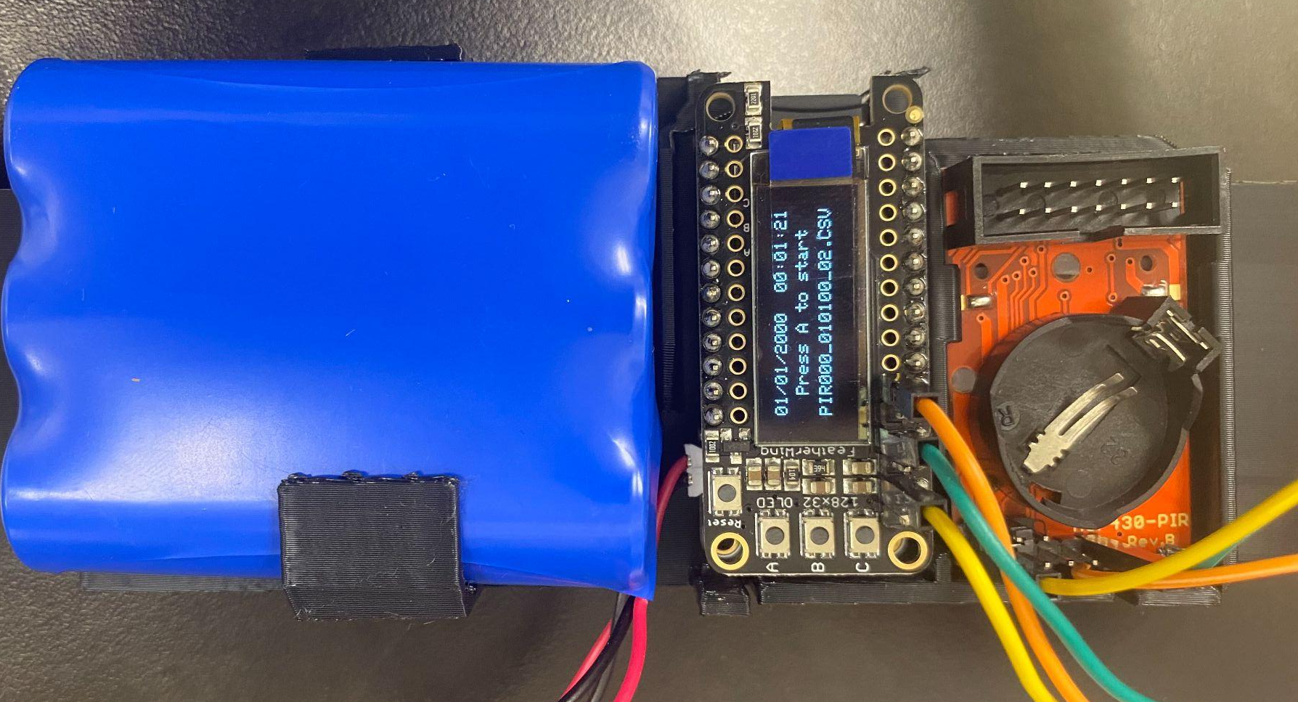
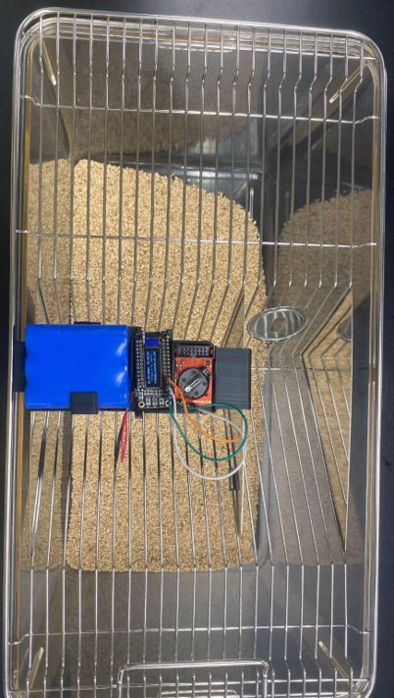
Rodent Activity Detector (RAD) Components
SD Card
Screen
Battery
PIR Sensor
A
B
Reset
Correct
Wiring

Slide 3

Setting up software
I use Arduino IDE to upload all required software from the computer to the RAD to make it functional.
First, I upload a time clock, which syncs the RAD to the current date and time (down to the second!), which is very important for data collection.
Then, I upload a PIR counter, giving each RAD a unique ID number
Link with all RADs details and instructions:
https://hackaday.io/project/160742/instructions

Slide 4
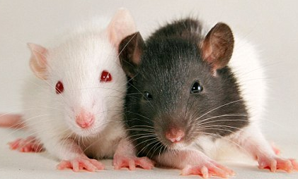
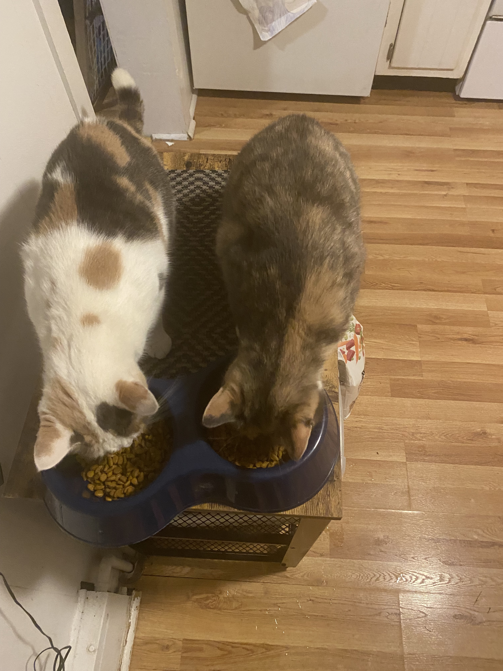
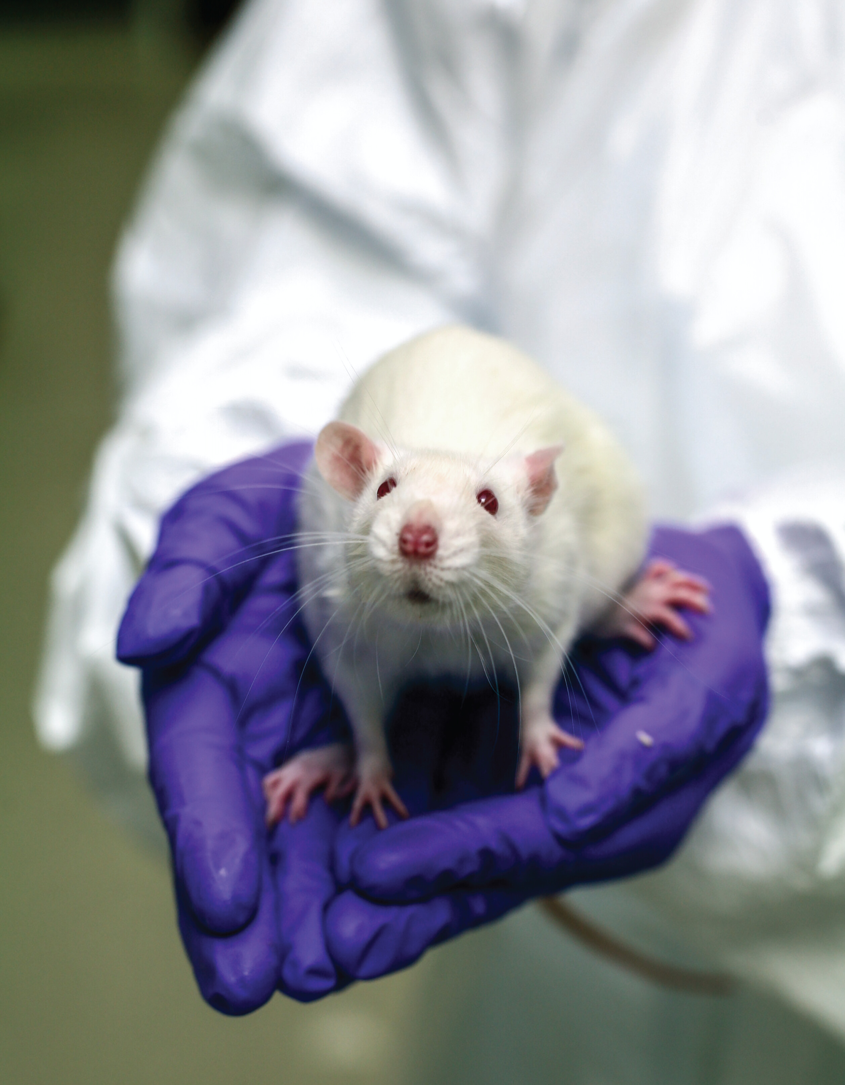
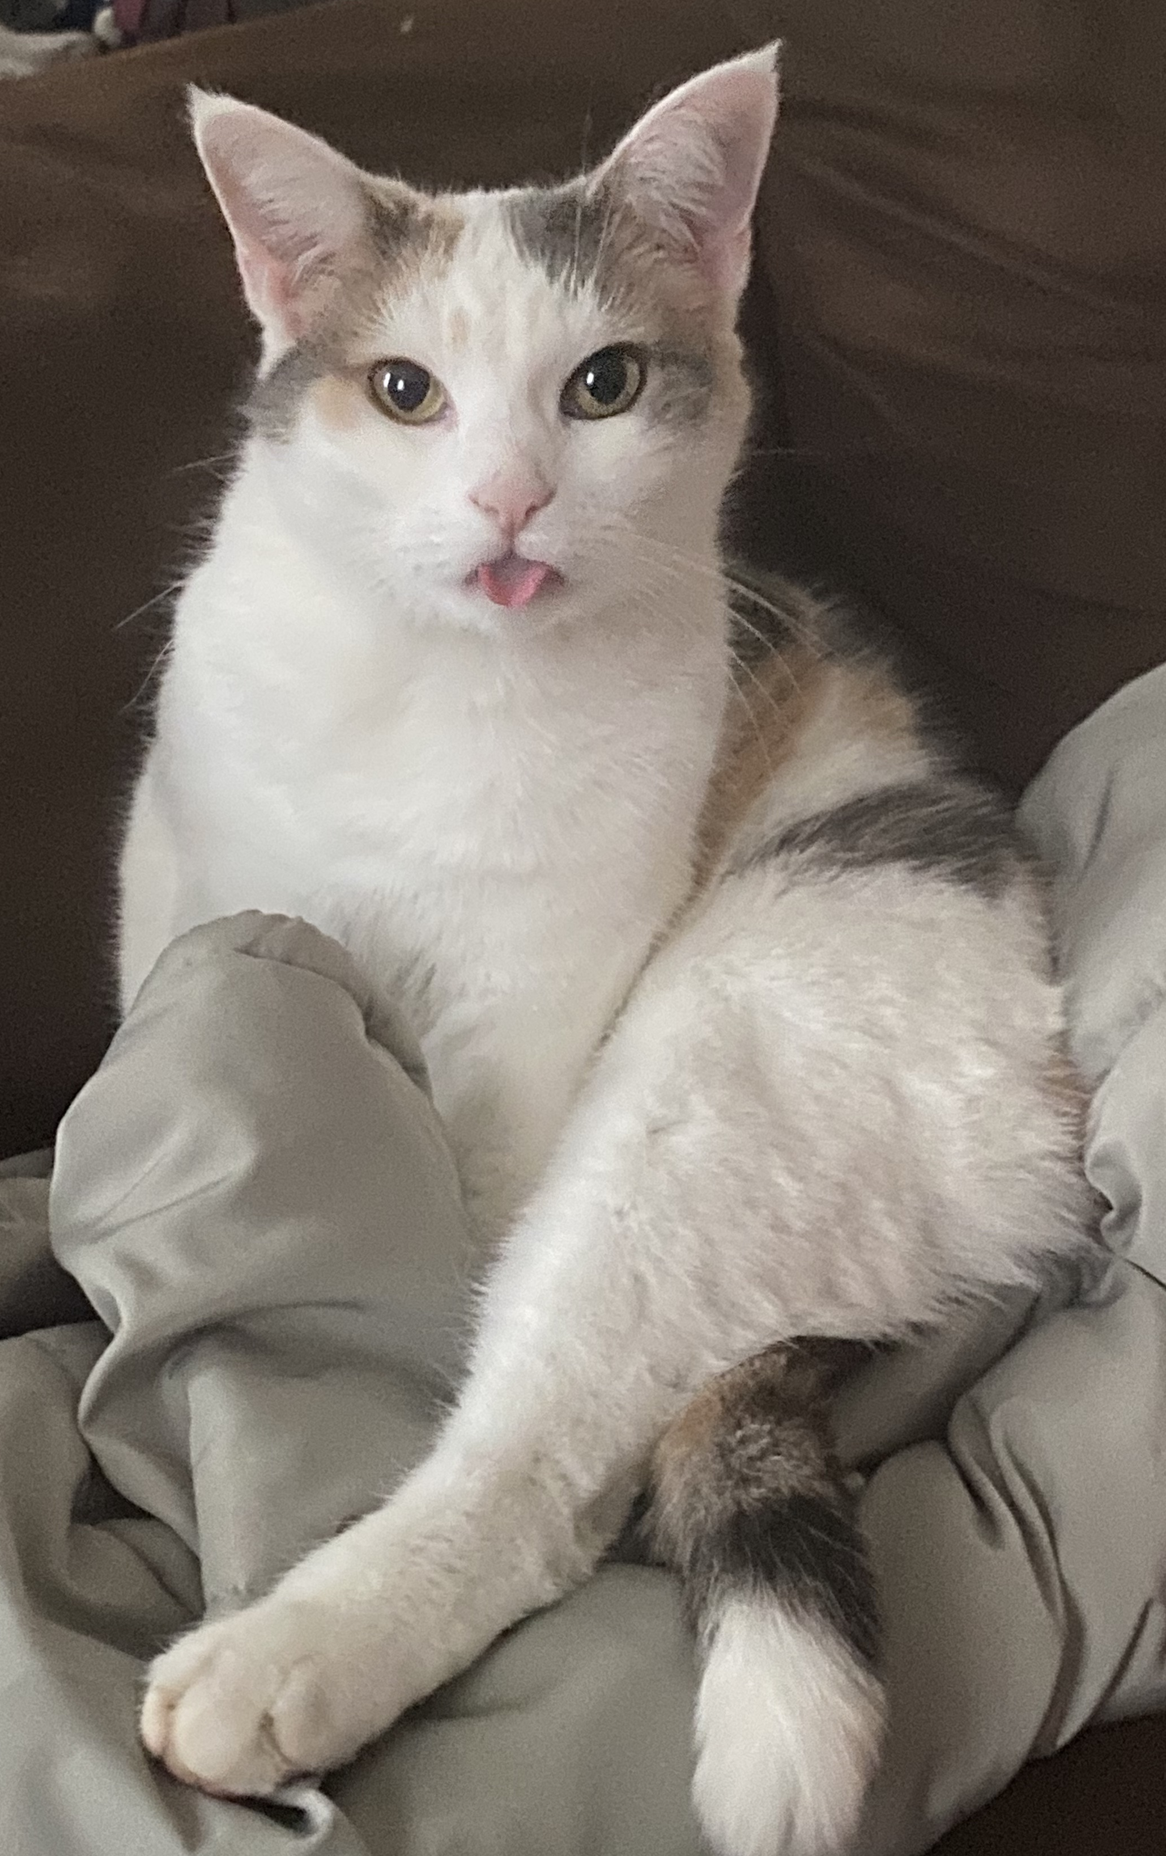
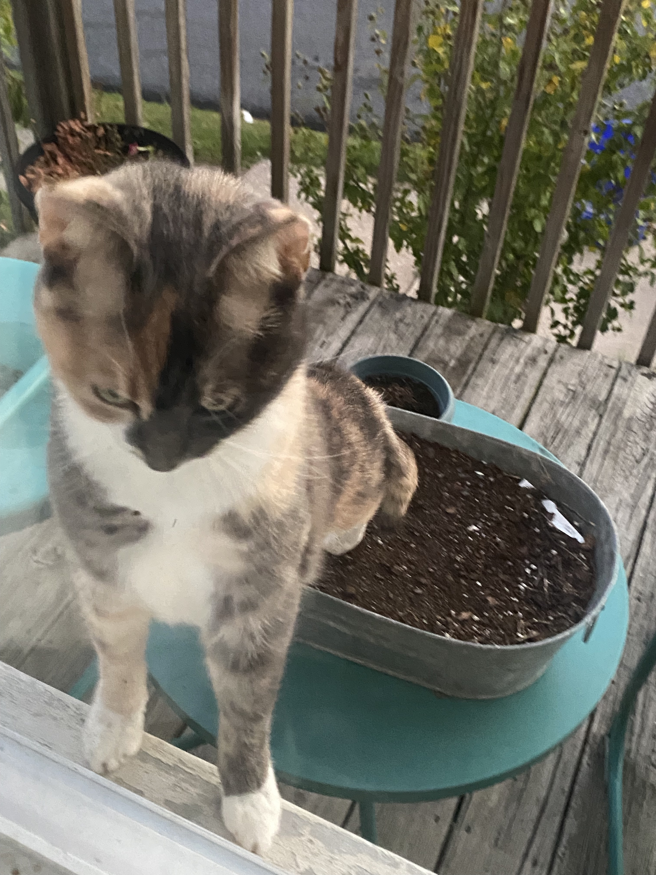
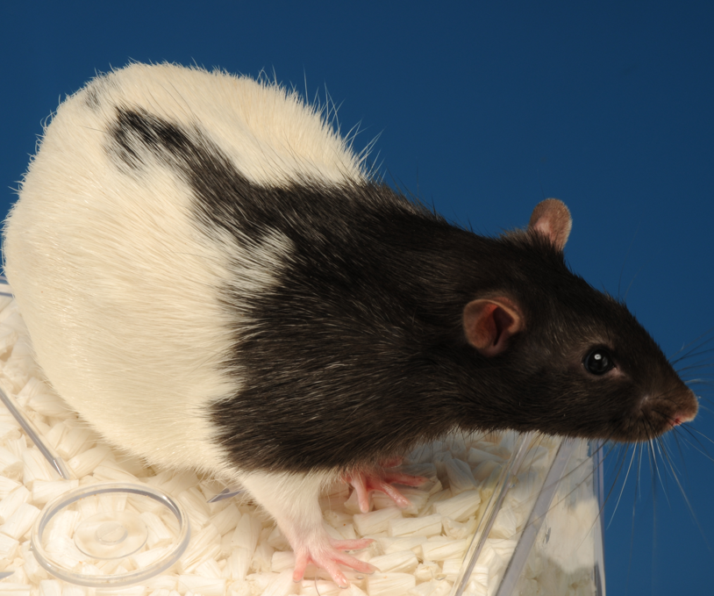




Player Characters
EVAN
DOLLY
MABEL
GRITS

